Slide 1
STATISTICAL TESTING & RESULTS

Slide 2
Customer Behaviour at SuperMarket
We have three models in our project:
・Shopping List & Money Model
・Shopping List & Time Model
・Shopping List, Money & Time Model
Shopping List & Money Model :In this model, customer agents finish shopping when a shopping list become empty or the amount of purchase money exceeds a budget.
Shopping List & Time Money: In this model, customer agents finish shopping when a shopping list become empty or the staying time exceeds a schedule.
Shopping List,Money & Time Model : In this model, customer agents finish shopping when a shopping list become empty, the amount of purchase money exceeds a budget or the staying time exceeds a schedule.

Slide 3
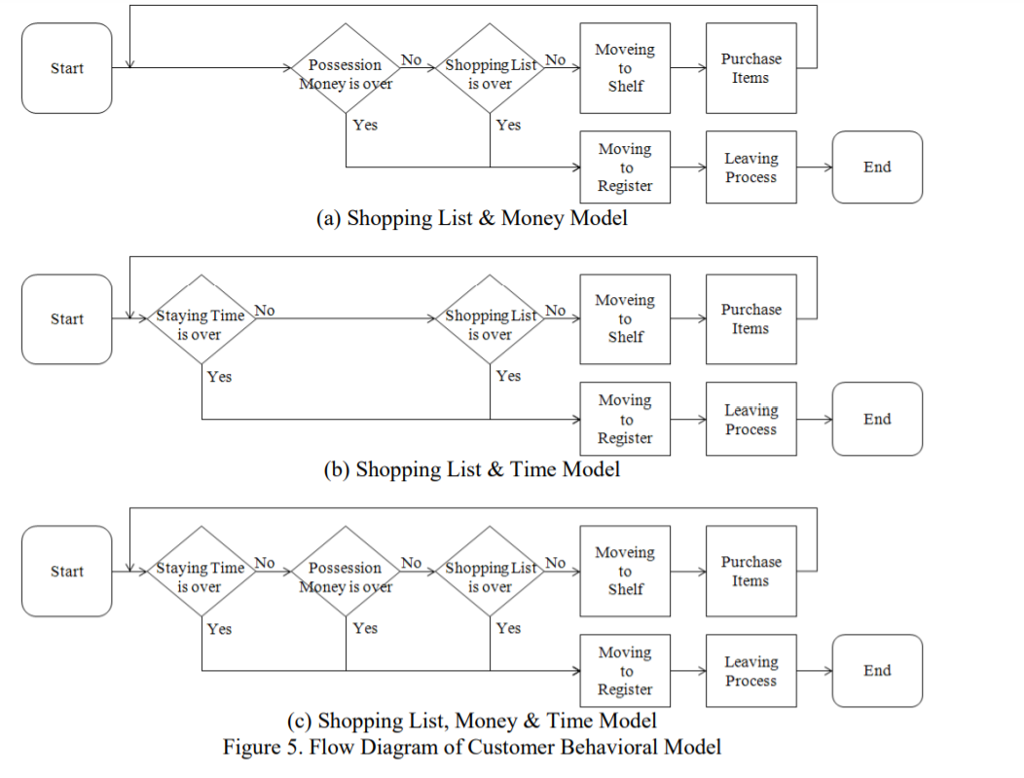
Three models working:

Slide 4
We run the three models for 1000 ticks three times and find the values of average possesion money and total customers .
We plot graphs for each model to understand the basic statistics of the model.
For model 1:
Plot : Average possesion money vs Total Customers
( Since We ignore the staying time in the model)
For model 2 :
Plot : Average staying time vs Total Customers
( Since we ignore the possesion money in the model)
For model 3 :
Plot 1 : Average possesion money vs Total Customers
Plot 2 : Average staying time vs Total Customers

Slide 5
Model 1: Shopping List & Money

Slide 6
Model 2:Shopping List & Time

Slide 7
Model 3: Shopping List,Money & Time

Slide 8
Model 3: Shopping List,Money & Time

Slide 9
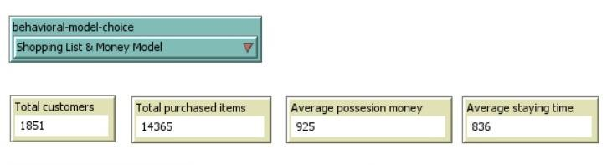
Experiment number of Purchased Items
To calculate Which among the three models are better We find the total purchased items count and run it for 1849 customers.
Observe the number of Purchased number of Items for every model run.
SHOPPING LIST & MONEY MODEL:

Slide 10
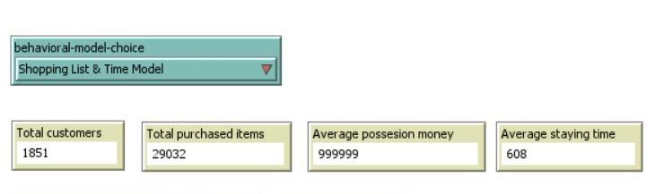
Experiment number of Purchased Items
SHOPPING LIST & TIME MODEL:

Slide 11
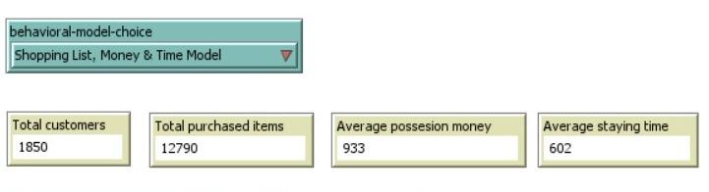
Experiment number of Purchased Items
SHOPPING LIST,MONEY & TIME MODEL:

Slide 12
Table for Experiment of Purchased items
Types of models | Samples | Purchased Number | Error rate
Real life values | 1849 | 18882 | 0
Shopping list & Money model | 1849 | 14365 | -23.9
Shopping List & Time model | 1851 | 29032 | +53.7
Shopping List,Money & Time model | 1850 | 12790 | -32.2

Slide 13
Experimental Results: The above table shows the number of purchased items for every model for customers.We adjusted the number of customers such that it matches the article(1849 customers).The model in which the shopping list becomes empty or the staying time exceeds the schedule.
Which clearly suggests that “Shopping List & Time model” has been the best for customer behaviour and also suggests they buy more Products under those restrictions.

Slide 14
Conclusion: This model has presented a customer behavioral model for testing the number of purchase items in Agent-Based In-Store Simulator (ABISS). We have described the setups and the analyzing results of field study, and the models which changed a stopping condition of shopping and experimental results of ABISS.We have decided the limit from "Shopping List", "Staying Time", and "Possession Money Limit". The experimental results have suggested that we can ground the number of purchasing items in ABISS to POS data if we consider only “Shopping List” and “Possession Money Limit”.

